Slide 1
Computer Vision Project 1
卢郡然
502024330034
lujunran@foxmail.com

Slide 2
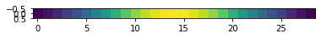
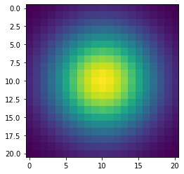
Part 1: Image filtering
[insert visualization of Gaussian kernel from proj1.ipynb here]
First calculates the required padding size. pad_h = k // 2 and pad_w = j // 2, where k and j are the height and width of the filter respectively.
The np.pad function is used to perform zero-padding on the image.
The function processes each channel of the image separately. For each pixel position (y, x) in the image, extract a region (patch) with the same size as the filter from the padded image. Calculate the sum of the element-wise products (dot product) between this region and the filter: np.sum(patch * filter). Store the result at the corresponding position in the output image. A stride of 1 is used. The convolution results are calculated pixel by pixel through a three-layer nested loop (channels, rows, columns).

Slide 3
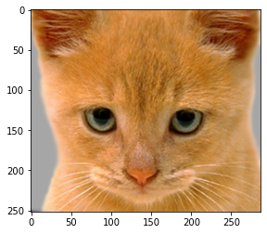
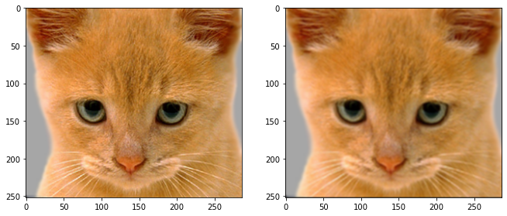
Part 1: Image filtering
Identity filter
Small blur with a box filter

Slide 4
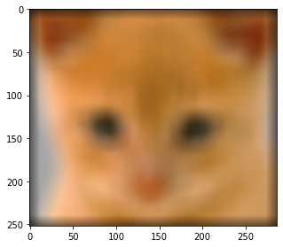

Part 1: Image filtering
my_conv2d_numpy with `version="v2"` (larger_blur_image).
V2 uses edge padding instead of zero padding and adopts a more efficient vectorized implementation to improve performance.

Slide 5
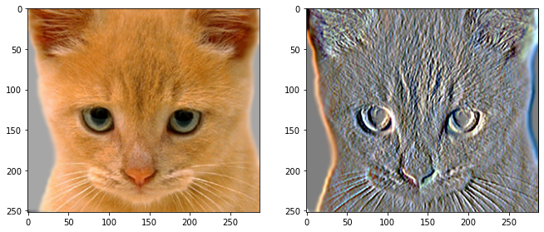
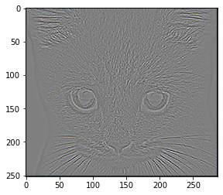
Part 1: Image filtering
Sobel filter
Discrete Laplacian filter

Slide 6
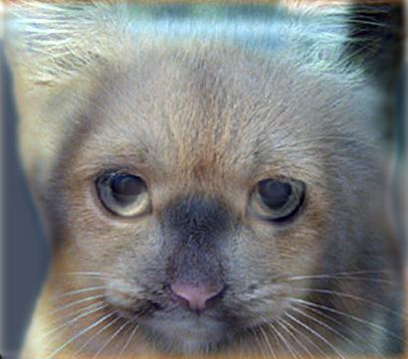
Part 1: Hybrid images
[Describe the three main steps of create_hybrid_image() here. Explain how to ensure the output values are within the appropriate range for matplotlib visualizations.]
Three Main Steps:
1. Extract Low Frequencies from Image1
2. Extract High Frequencies from Image2
3. Combine and Normalize
To ensure output values are appropriate:
The function uses np.clip(hybrid_image, 0, 1) to guarantee all pixel values stay within matplotlib's expected [0, 1] range for float imagesThis prevents overflow/underflow artifacts during visualizationThe clipping is done after combining the frequency components but before returning the result
Cat + Dog
Cutoff frequency: 7

Slide 7
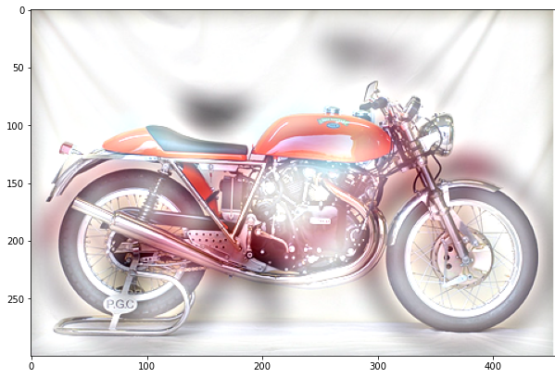
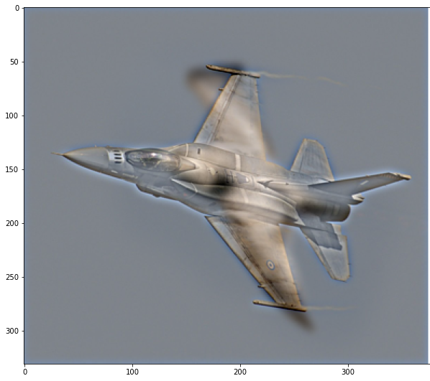
Part 1: Hybrid images
Motorcycle + Bicycle
Cutoff frequency: 10
Plane + Bird
Cutoff frequency: 4

Slide 8
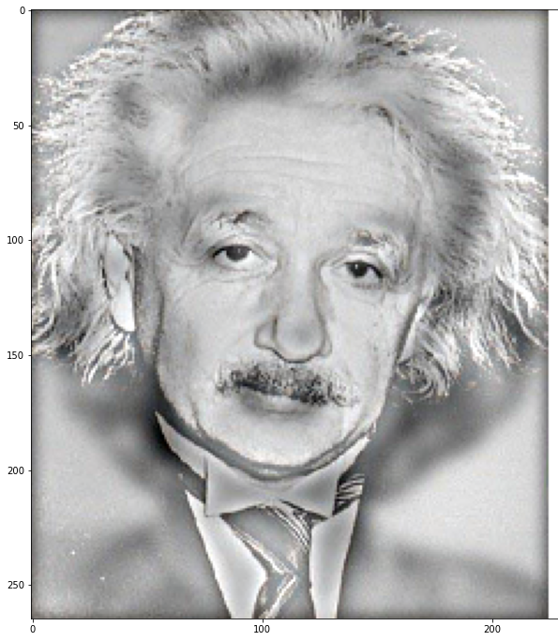
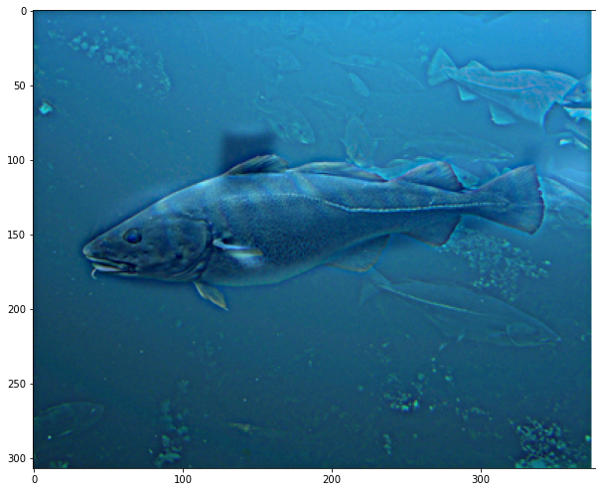
Part 1: Hybrid images
Einstein + Marilyn
Cutoff frequency: 4
Submarine + Fish
Cutoff frequency: 3

Slide 9
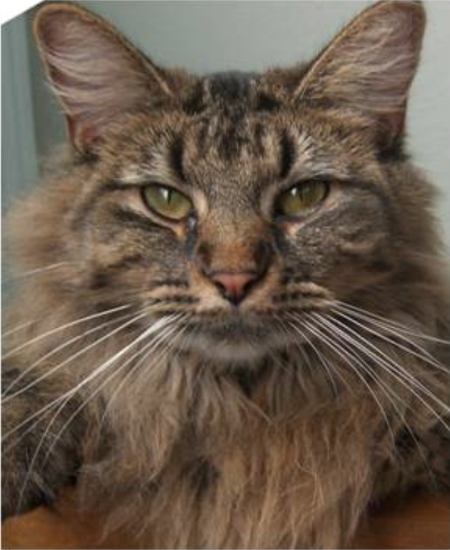
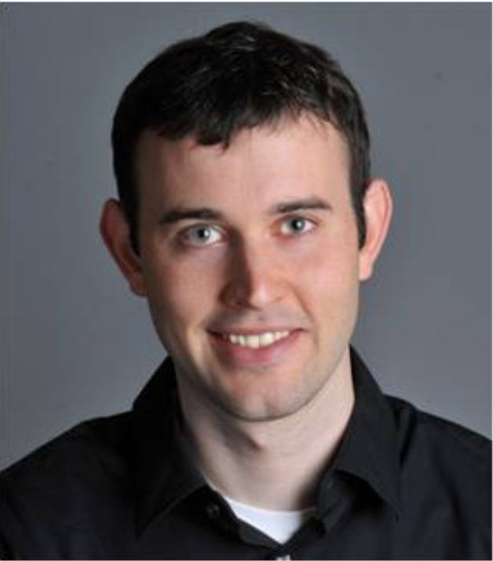
Part 1: Hybrid images
[insert your custom image pair (1.4)]

Slide 10
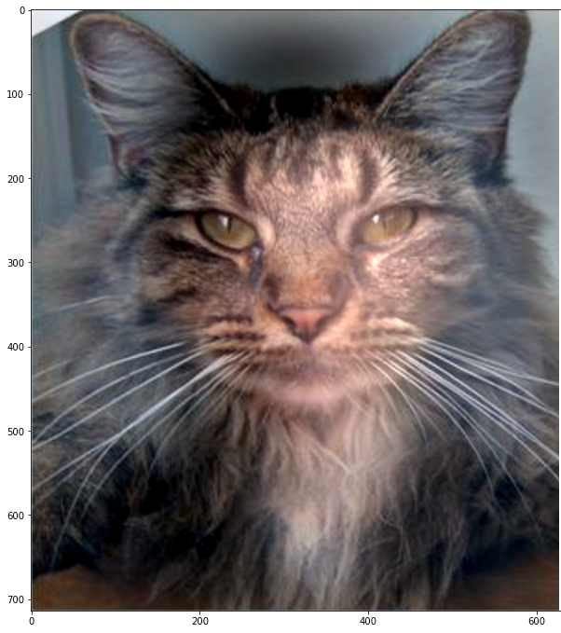
Part 1: Hybrid images
[insert your custom hybrid image (1.4)]
[analyze the factors that you believe determine whether an image pair can successfully form a well hybrid image (1.4)]
When both source images are spatially aligned, semantically related, and have distinguishable frequency components. Properly tuning the cutoff frequency allows one image to contribute primarily low frequencies while the other contributes high frequencies, enabling clear perception at different viewing distances. Consistent color, contrast, and scale between the images also help maintain visual balance and prevent one image from overpowering the other.

Slide 11
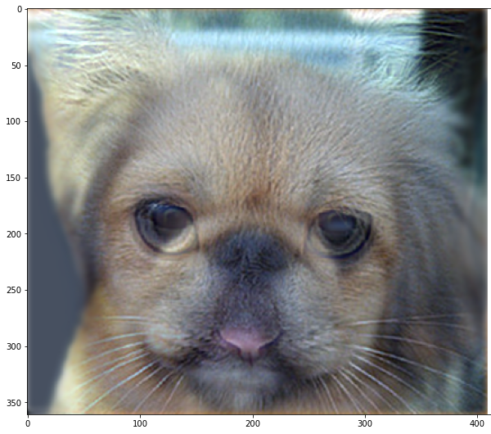
Part 2: Hybrid images with PyTorch
Cat + Dog
[insert your hybrid image here]
Motorcycle + Bicycle
[insert your hybrid image here]

Slide 12
Part 2: Hybrid images with PyTorch
Plane + Bird
[insert your hybrid image here]
Einstein + Marilyn
[insert your hybrid image here]

Slide 13
Part 2: Hybrid images with PyTorch
Submarine + Fish
[insert your hybrid image here]
Part 1 vs. Part 2
[Compare the run-times of Parts 1 and 2 here, as calculated in proj1.ipynb. Which method is faster?]
Pytroch implementation is faster

Slide 14
Part 2: Hybrid images with PyTorch
Different Image Pairs:
[Among the previous 5 image pairs, which ones do you think present better hybrid image results? What causes these differences?]
Einstein + Marilyn
1. Alignment of feature points: such as eyes, mouths, wheels, etc.
2. Images with obvious edges and high-frequency details (such as Einstein's wrinkles) are more likely to extract high-frequency information. Images with a clear overall contour (such as Marilyn's smooth face) are more suitable for extracting low-frequency information.
3. Image pairs with similar structures but different details (such as face to face) have the best effect.
A large contrast in shape and texture will affect the blending effect.

Slide 15
Part 3
[Consider a 1-channel 5x5 image and a 3x3 filter. What are the output dimensions of a convolution with the following parameters?
Stride = 1, padding = 0?
Stride = 2, padding = 0?
Stride = 1, padding = 1?
Stride = 2, padding = 1?]
3 x 3
2 x 2
5 x 5
3 x 3
[What are the input & output dimensions of the convolutions of the dog image and a 3x3 filter with the following parameters:
Stride = 1, padding = 0
Stride = 2, padding = 0
Stride = 1, padding = 1
Stride = 2, padding = 1?]
1. 359 x 408 x 3
2. 180 x 204 x 3
3. 361 x 410 x 3
4. 181 x 205 x3

Slide 16
Part 3
[How many filters did we apply to the dog image?]
[identity_filter],
[blur_filter],
[sobel_filter],
[laplacian_filter],
[Why do the output dimensions adhere to the equations given in the instructions handout?]
The output dimensions follow the equations because they calculate how many times the kernel can slide over the input image, considering the stride and padding. Each step of the kernel must fully fit within the padded input, and the equations ensure this by dividing the effective input size by how much the kernel shifts each time (stride), accounting for padding.

Slide 17
Part 3
[What is the intuition behind this equation?]
The numerator represents the total effective length available for kernel movement, after accounting for padding and kernel size. Dividing by the stride gives the number of steps the kernel can move across the input. The addition of 1 accounts for the initial position of the kernel at the beginning of the input. Thus, the formula ensures that the kernel remains fully within the padded input at each step, producing valid output dimensions.

Slide 18
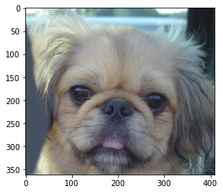

Part 3
[insert visualization 0 here]
[insert visualization 1 here]

Slide 19
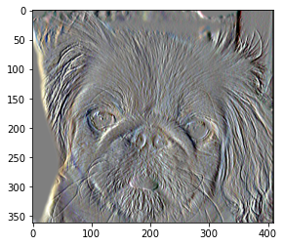
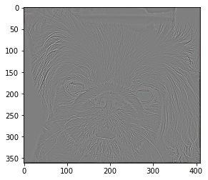
Part 3
[insert visualization 2 here]
[insert visualization 3 here]

Slide 20
Conclusion
[How does varying the cutoff frequency value or swapping images within a pair influences the resulting hybrid image?]
Varying cutoff frequency changes the amount of high and low-frequency content from each image. A higher cutoff retains more detail , which means less blur, while a lower cutoff removes more high-frequency information, which means more blur, impacting which image dominates perception at different viewing distances.
Swapping images changes which image contributes high vs. low frequencies. This alters the hybrid image's perceptual dominance: the image providing high frequencies tends to be more noticeable at close range, while the low-frequency image is more visible from afar.

Slide 21
Part 4: Frequency Compression and Image Filtering
[Describe your implementation details in words, including the calculation of PSNR and retention ratio, as well as the compression strFrequency Compression Process:
The image is first converted to grayscale if it's a color image. 2D Fast Fourier Transform (FFT) is applied to get frequency domain representation
The frequency spectrum is shifted to center the zero frequency component. A circular low-pass mask is created based on the retention ratio parameter. The mask is applied to preserve only low-frequency components. Inverse FFT is performed to reconstruct the compressed image
PSNR Calculation:
Mean Squared Error (MSE) is calculated between original and compressed images. PSNR is computed as: 20 * log10(MAX_I/√MSE), where MAX_I=1 for normalized images. Higher PSNR indicates better quality preservation.
Retention Ratio: calculated as: min(H,W)*ratio/2. Only frequencies within this radius from the center are preserved
Compression Strategy:
Progressive compression is demonstrated by testing multiple ratios (0.1, 0.3, 0.5, 0.7)
The method preserves overall image structure while discarding high-frequency details
Visual results and PSNR values are shown for each compression levelategy and process.

Slide 22
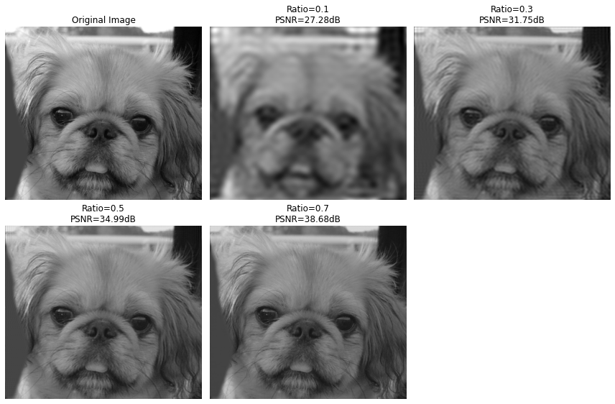
Part 4: Frequency Compression and Image Filtering

Slide 23
Part 4: Frequency Compression and Image Filtering
[Thinking: How to reduce retention ratio while maintaining quality?]
Retain the highest-magnitude frequencies instead of a fixed cutoff, preserving perceptually critical components.
Use a shape that better matches the energy distribution in the frequency domain, like circular mask, to capture more relevant frequencies with fewer coefficients.
Dynamically adjust retention based on image characteristics, like, prioritize low frequencies for smooth regions, retain key high frequencies for edges).

